Slide 1

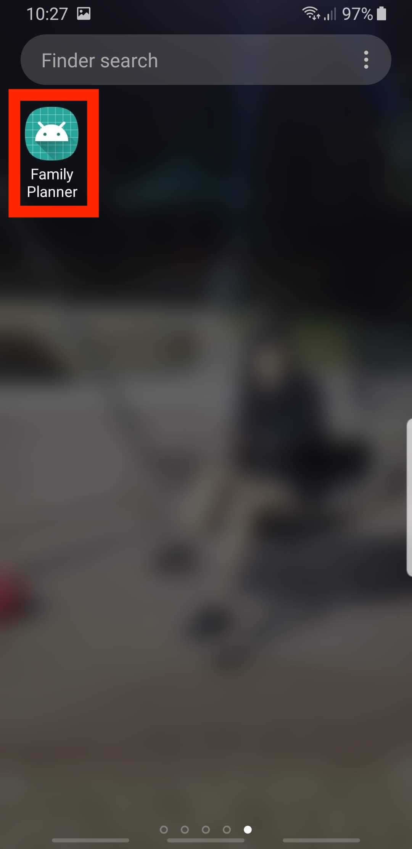
Directions to Download the Family Planner App

Slide 2
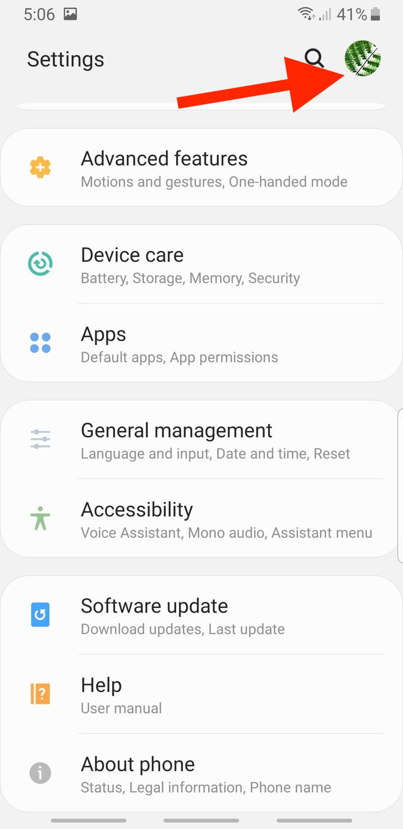
Step 1:
Go to Settings on your device and click this icon

Slide 3
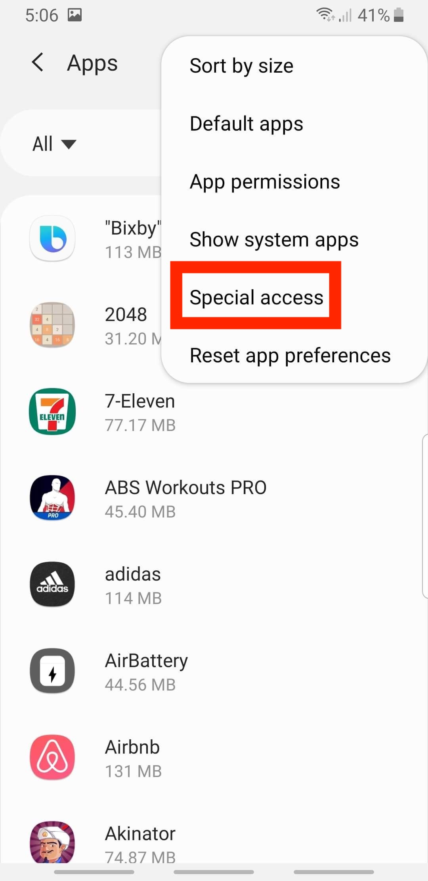
Step 2:
Select Special Access

Slide 4
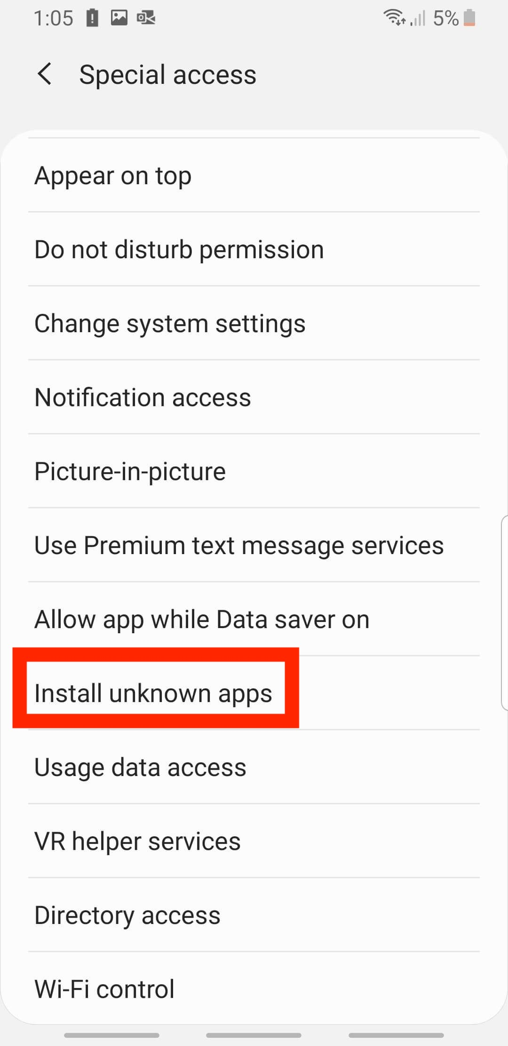
Step 3:
Select Install Unknown Apps

Slide 5
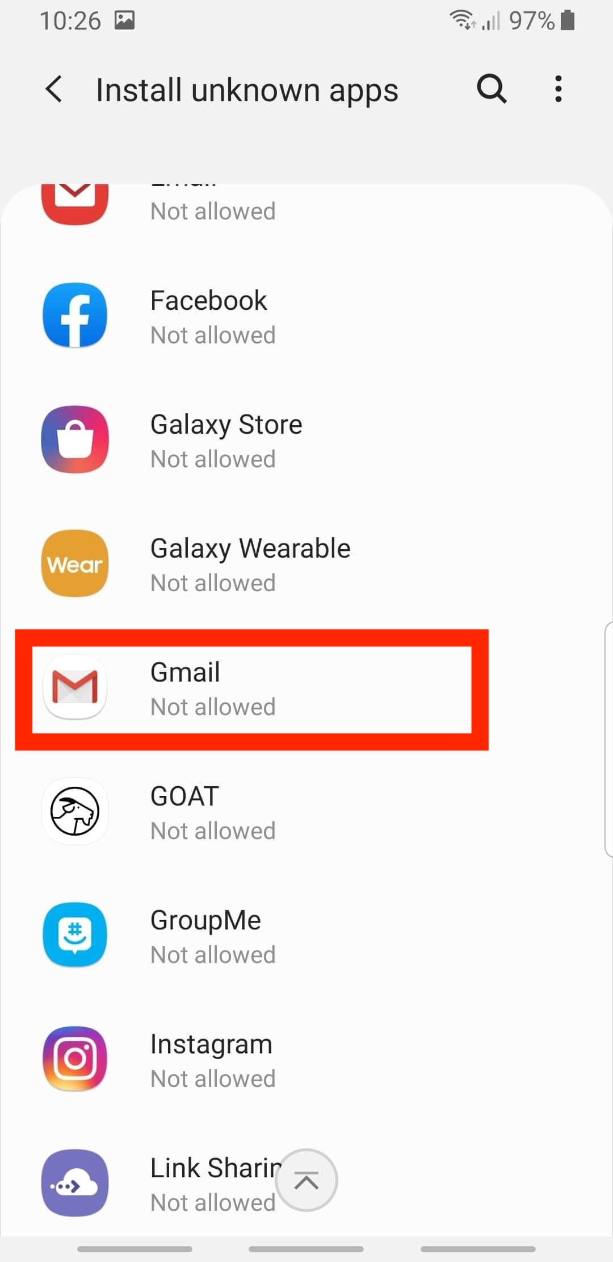
Step 4:
Select Gmail to allow download from this source

Slide 6
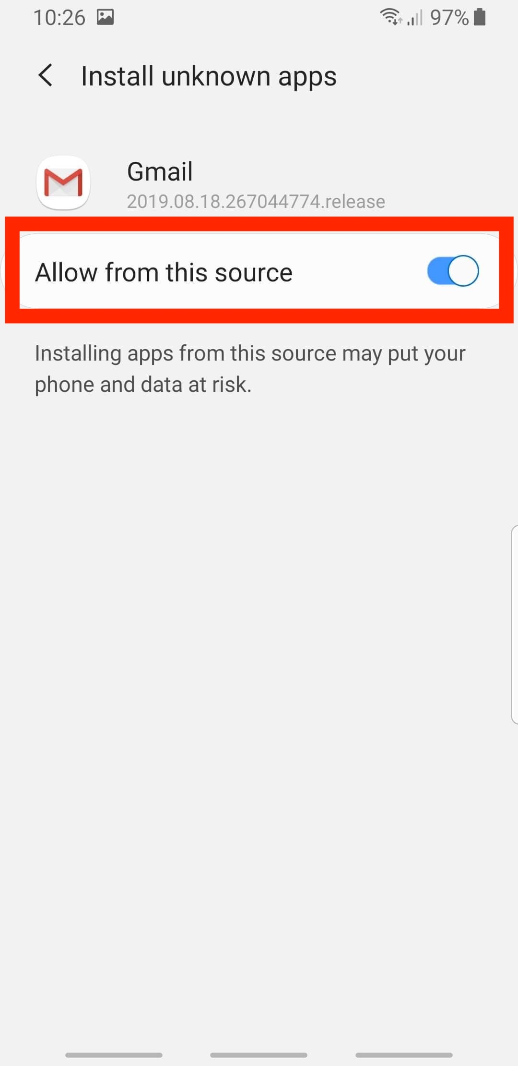
Step 5:
Turn the allow from this device toggle on

Slide 7
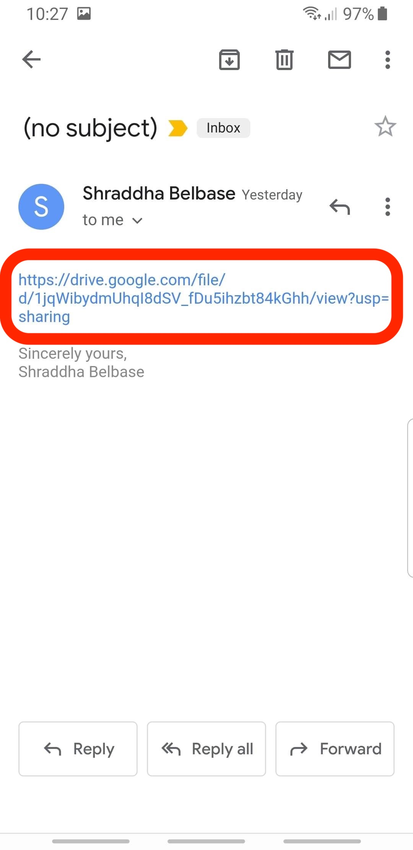
Step 6:
Go to your email and find the link for the app and click on it
LINK TO THE WEBSITE
You should have received the link from Dr.Panagos

Slide 8
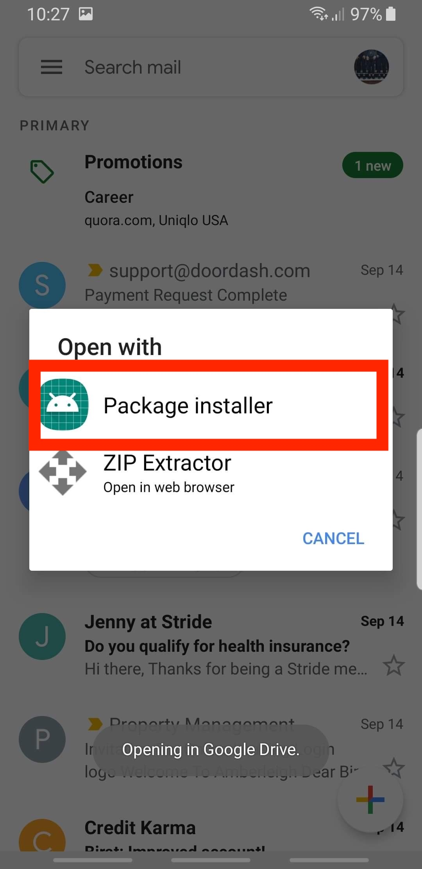
Step 7:
Click on Package Installer

Slide 9
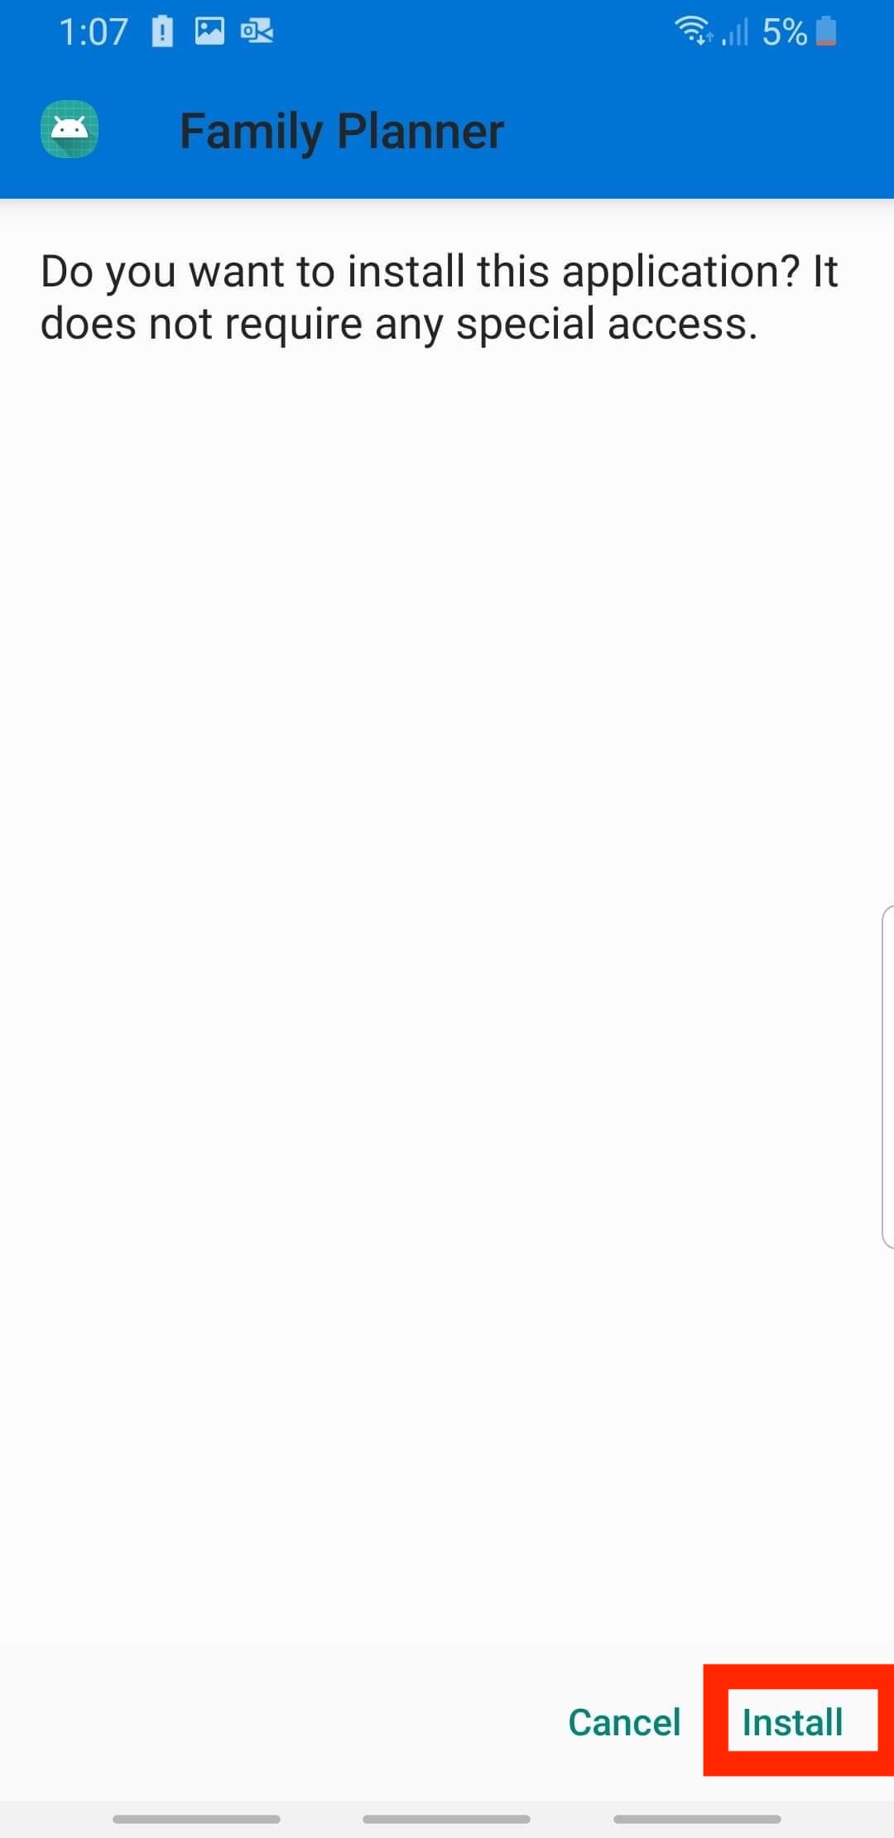
Step 8:
Click Install to install Family Planner in your device.

Slide 10
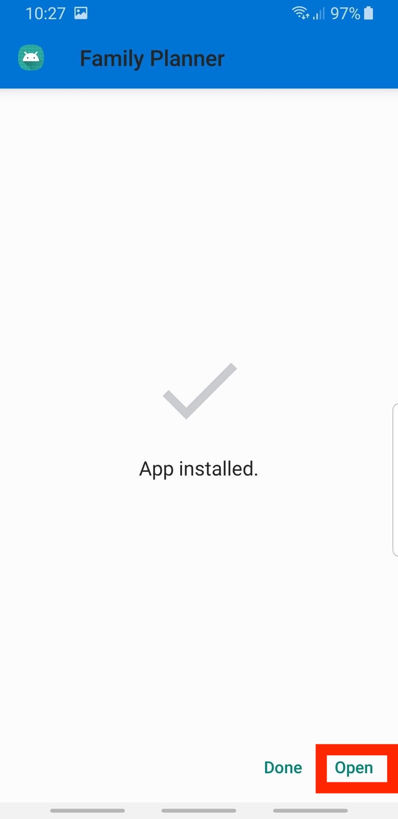
Step 9:
Once the app is downloaded in your device click open

Slide 11
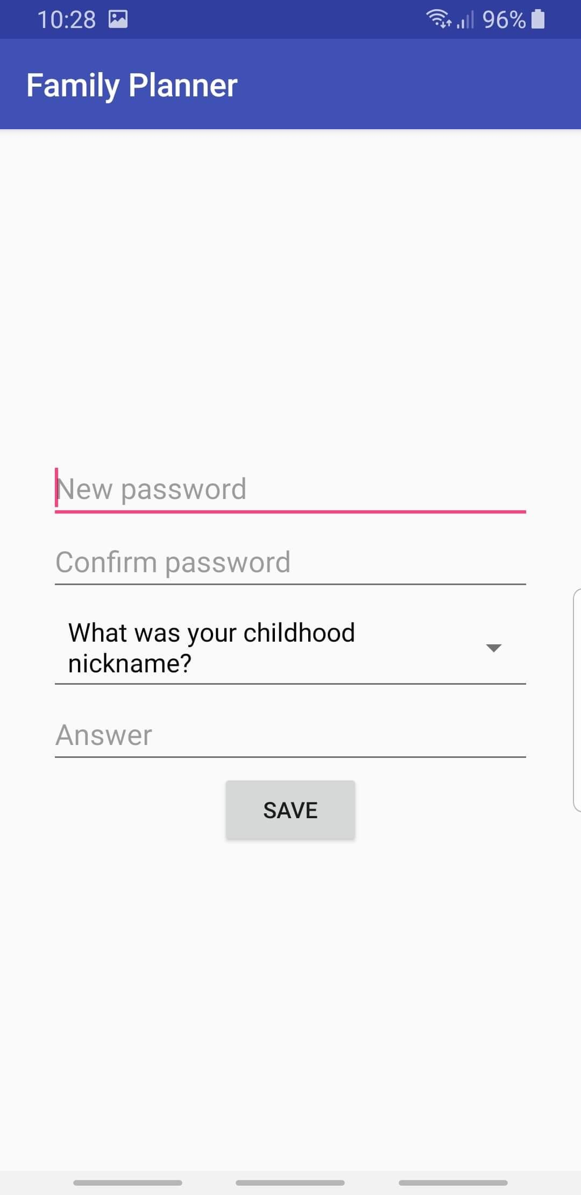
Step 10:
Congratulations. Family Planner is now installed and ready to use.

Slide 12
Step 11:
If it did not open by itself, locate the app in your device and open it.

