Slide 1
Family Planner Android App Demo
How the research works: The app is stored on the family’s phone. After the family sees a demo and agrees to participate in the research, the family downloads the app themselves on their own Android phone. The family enters all of the information on their phone. Each week the family shows each page of the app to the research team. The research team takes a photo with a university device of each page of the app as data for the research and emails the photos to be stored on a secure university drive. No information is downloaded from the family’s phone. The app does not use a server.
(All information is factitious. The model portraying Sammie is my grandson.)
This presentation shows data collected from a factitious family on the Family Planner Android App. For research purposes, photos are taken of each page.

Slide 2
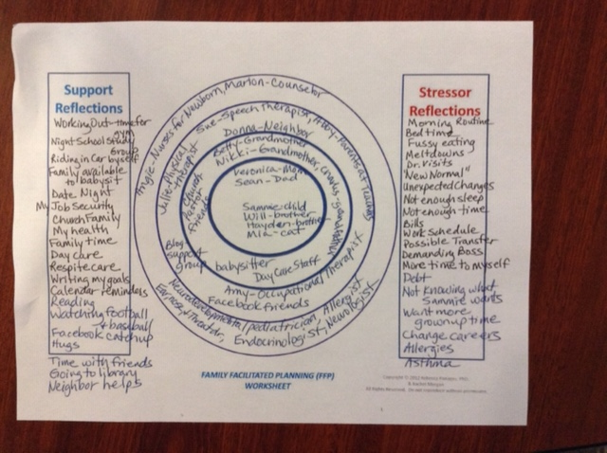
Original Family Planner Do-It-Yourself Tool

Slide 3
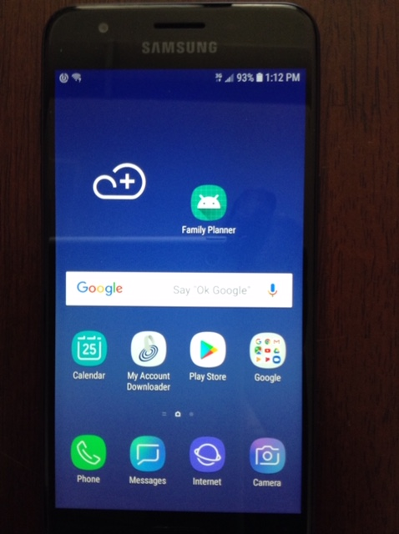

Slide 4
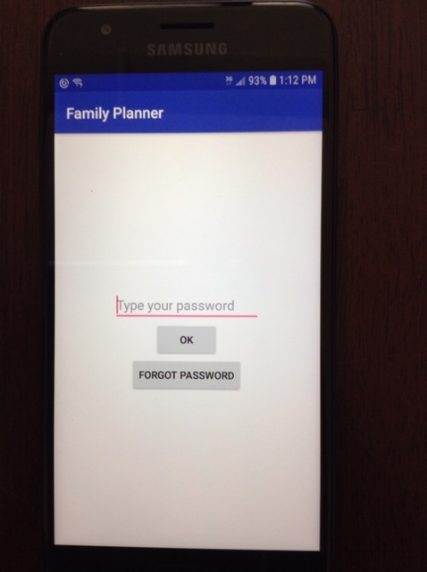
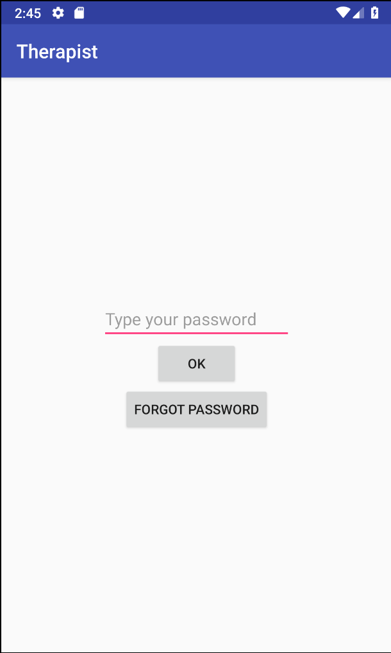

Slide 5
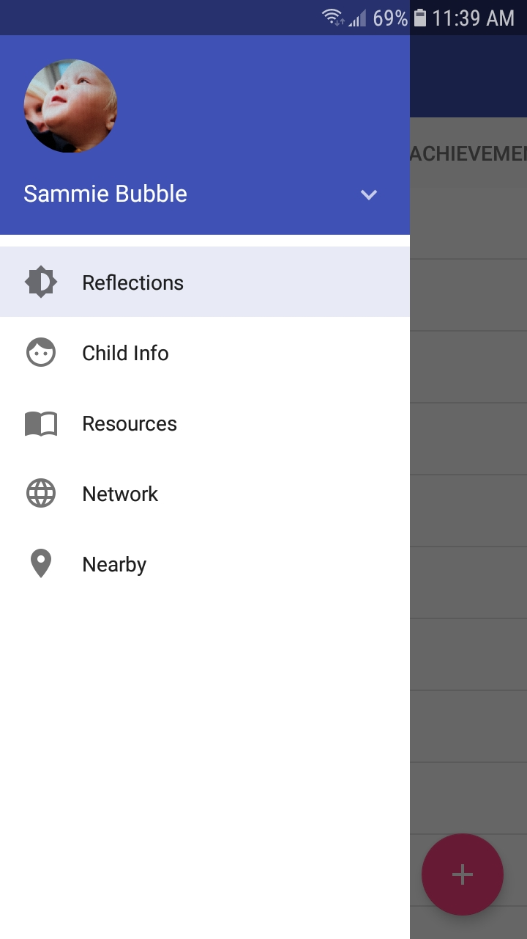
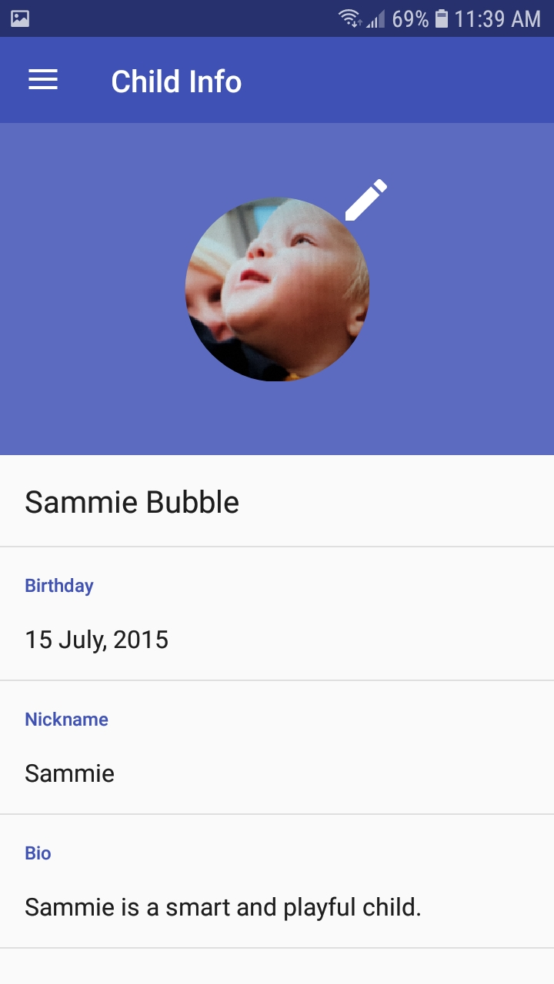

Slide 6
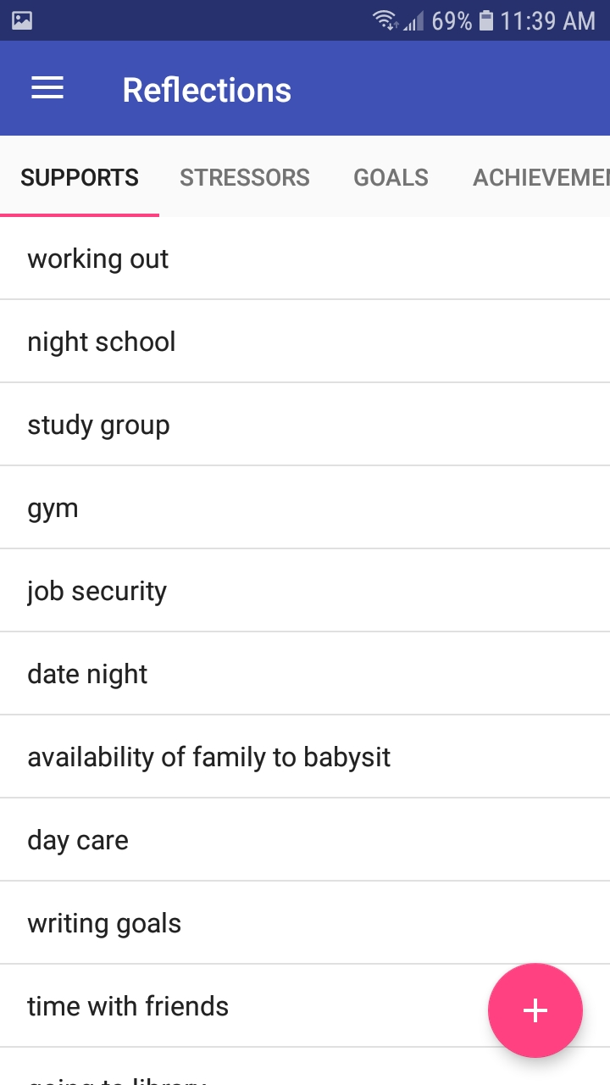

Slide 7
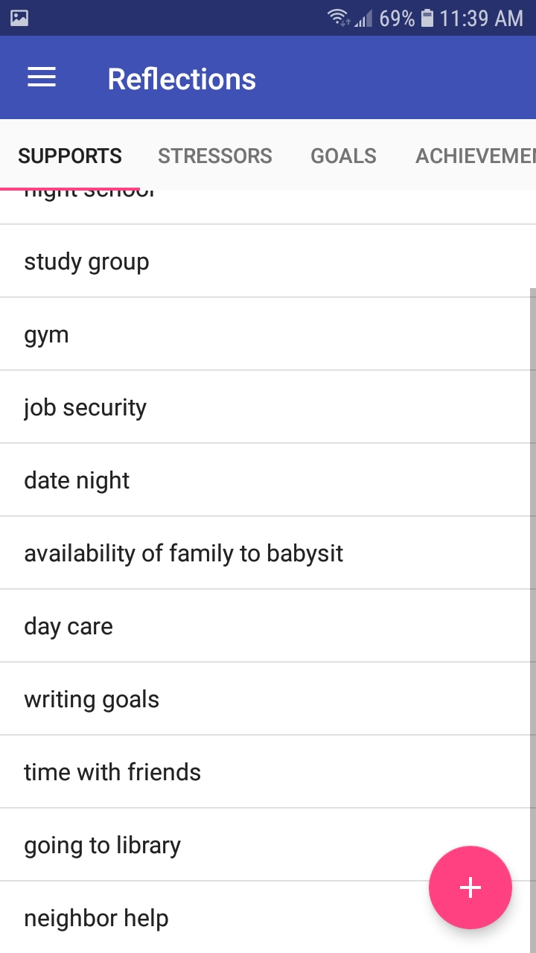

Slide 8
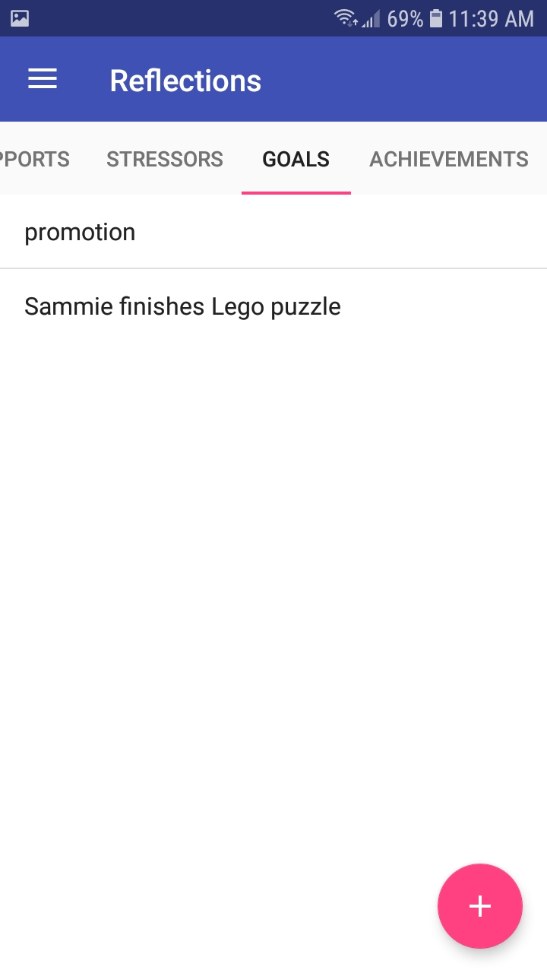

Slide 10
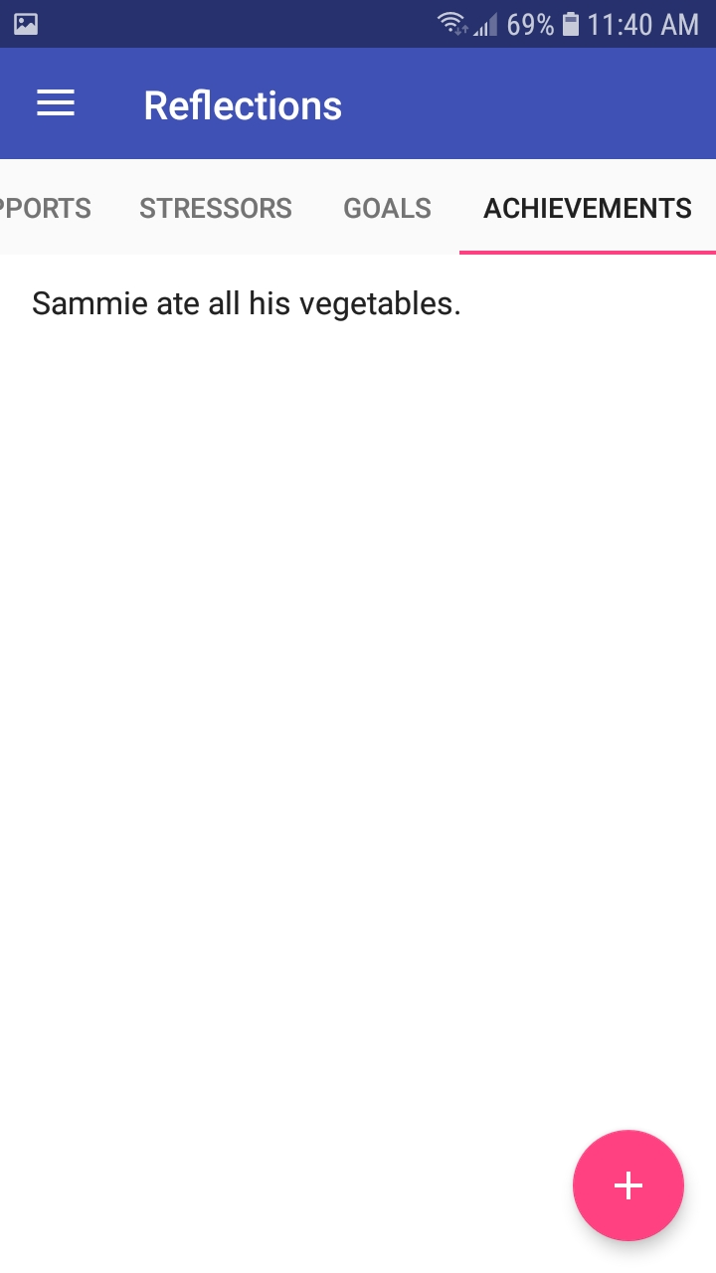

Slide 11
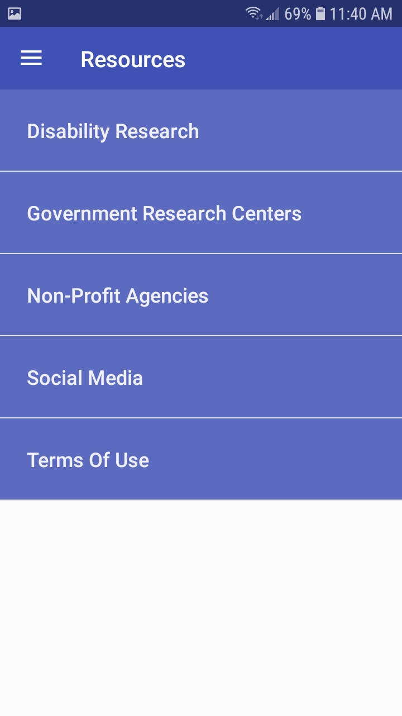

Slide 12
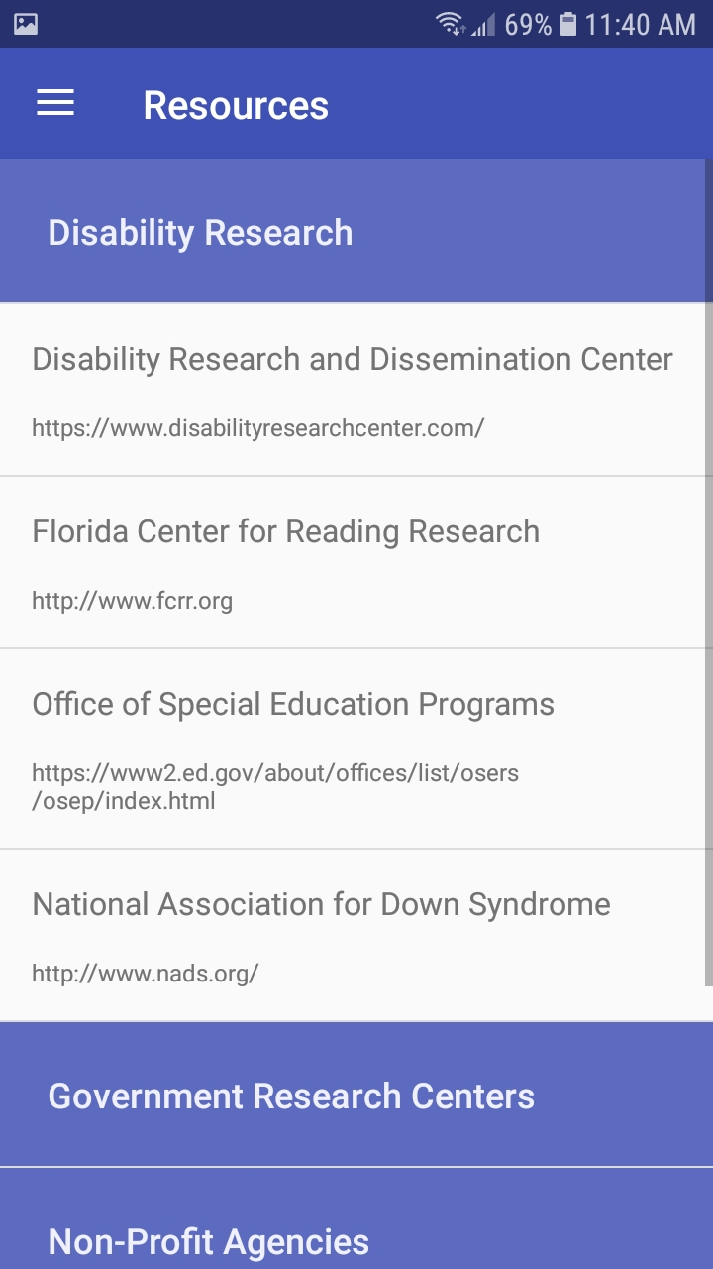

Slide 13
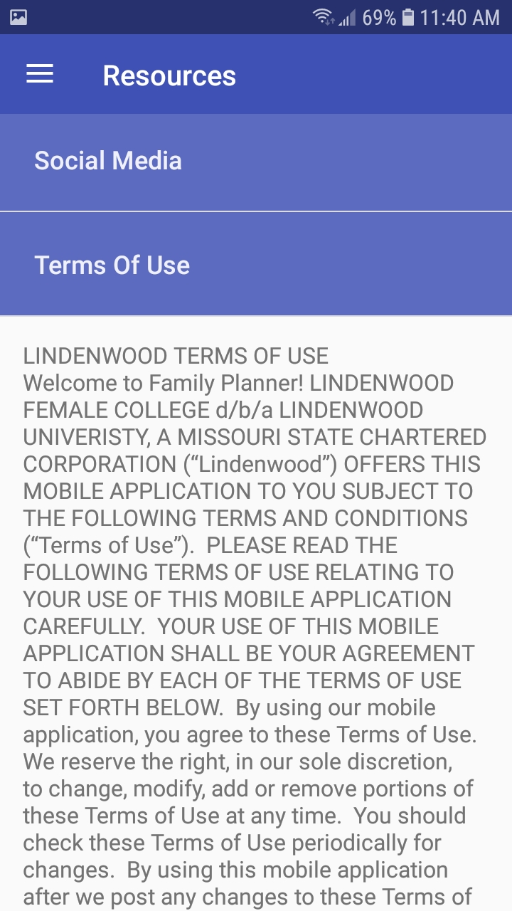

Slide 14
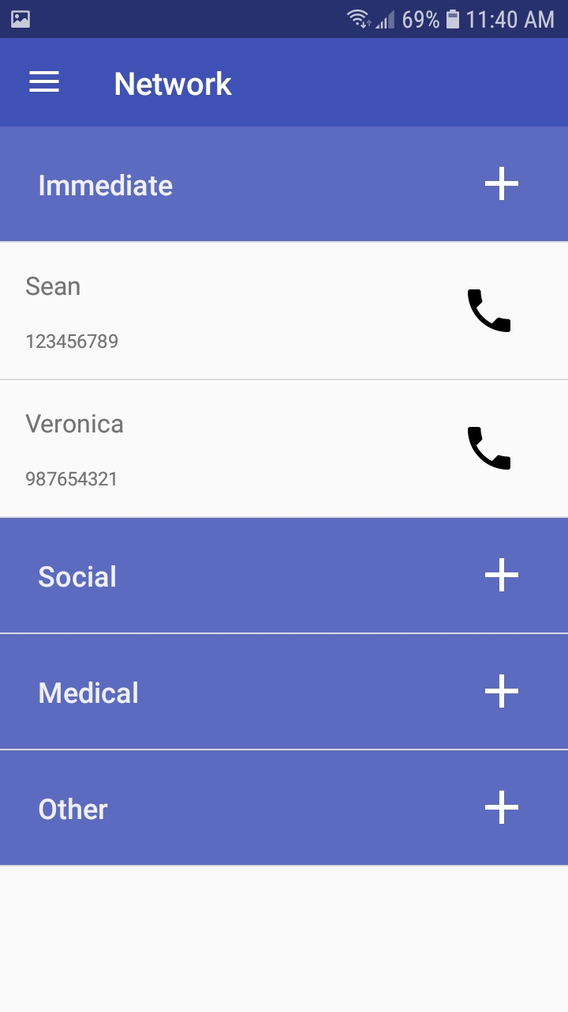

Slide 15
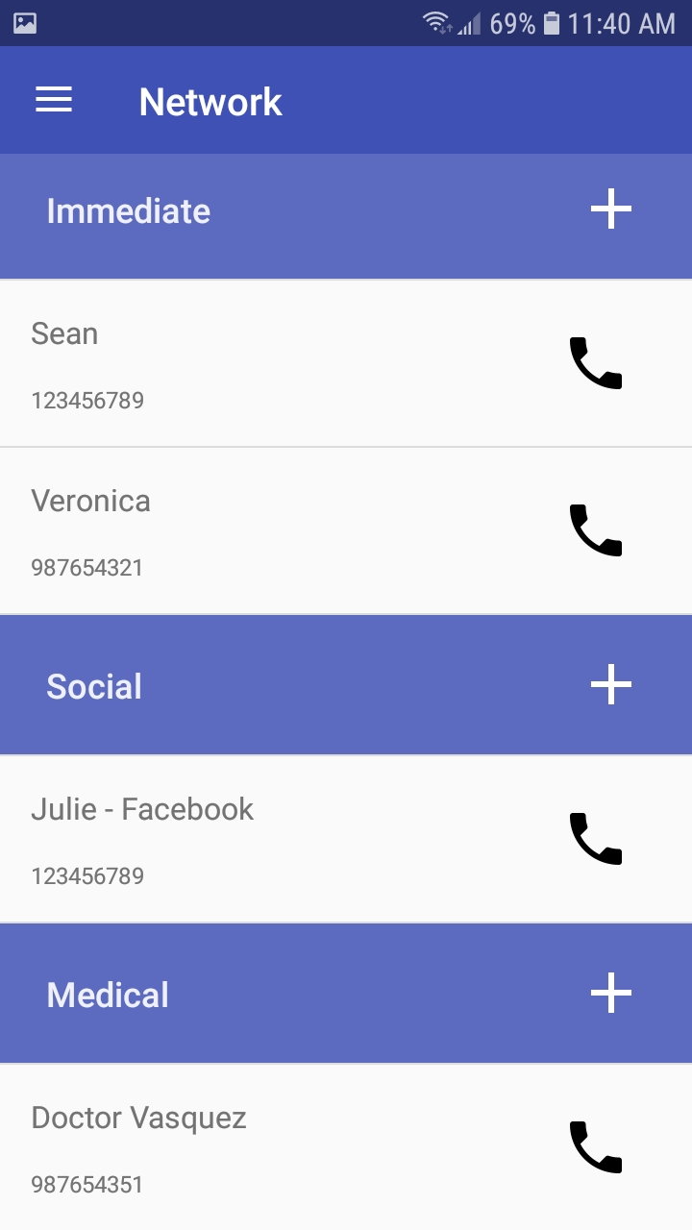

Slide 16
